Slide 1
ASW 2018
Final presentation
The department of Engeering ,the faculty of Image-Science
Chiba University in 4th year ungraduated school
Satoshi Furuya
Notes:
Good morning , Thank you for coming to hear my presentation. Although Everyone knows me, I would like to introduce me. My name is Satoshi Furuya, Nickname is Santo. I am 4th year ungraduated school student in Chiba University.

Slide 2
Contents
1 Culture in Thailand
2 Experiment and various things
Notes:
In this presentation, I am going to talk about 2 points. First Culture in Thailand ,Second Experiment and various things. Could everyone please hear my story? My speech will take about 15 minutes.

Slide 3

Culture in Thailand
Notes:
I will start with Culture in Thailand.

Slide 4
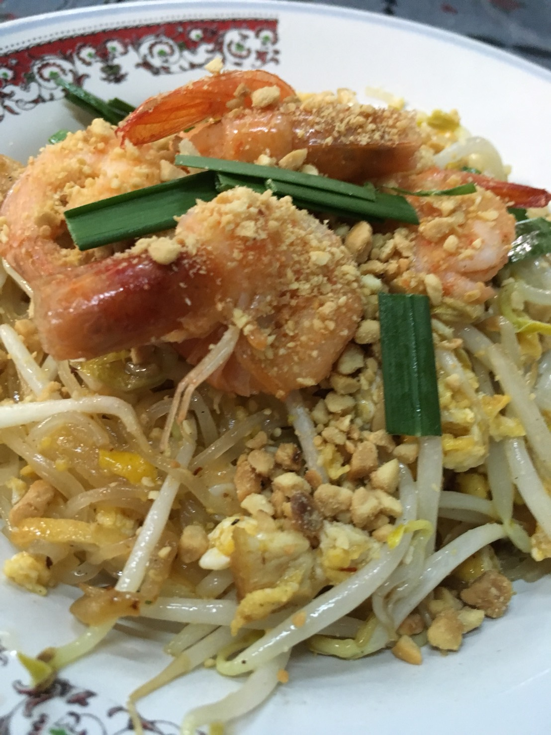
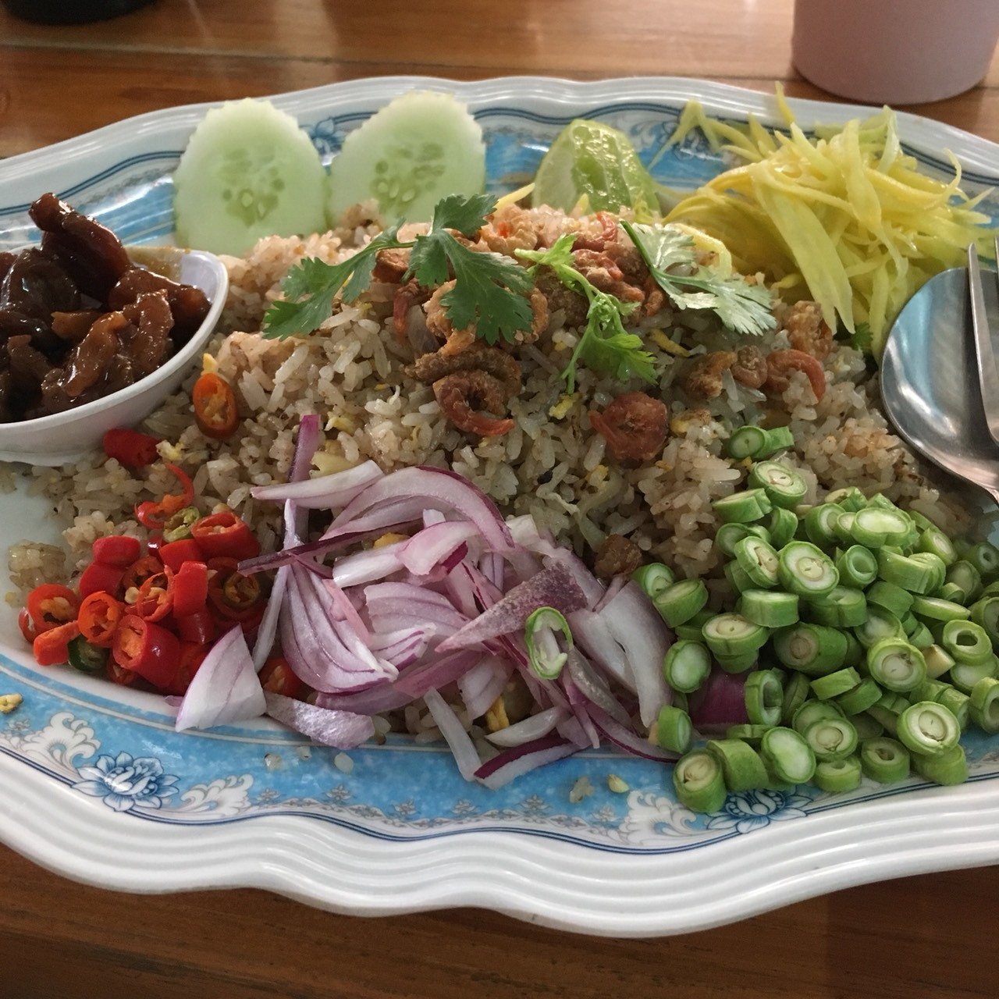
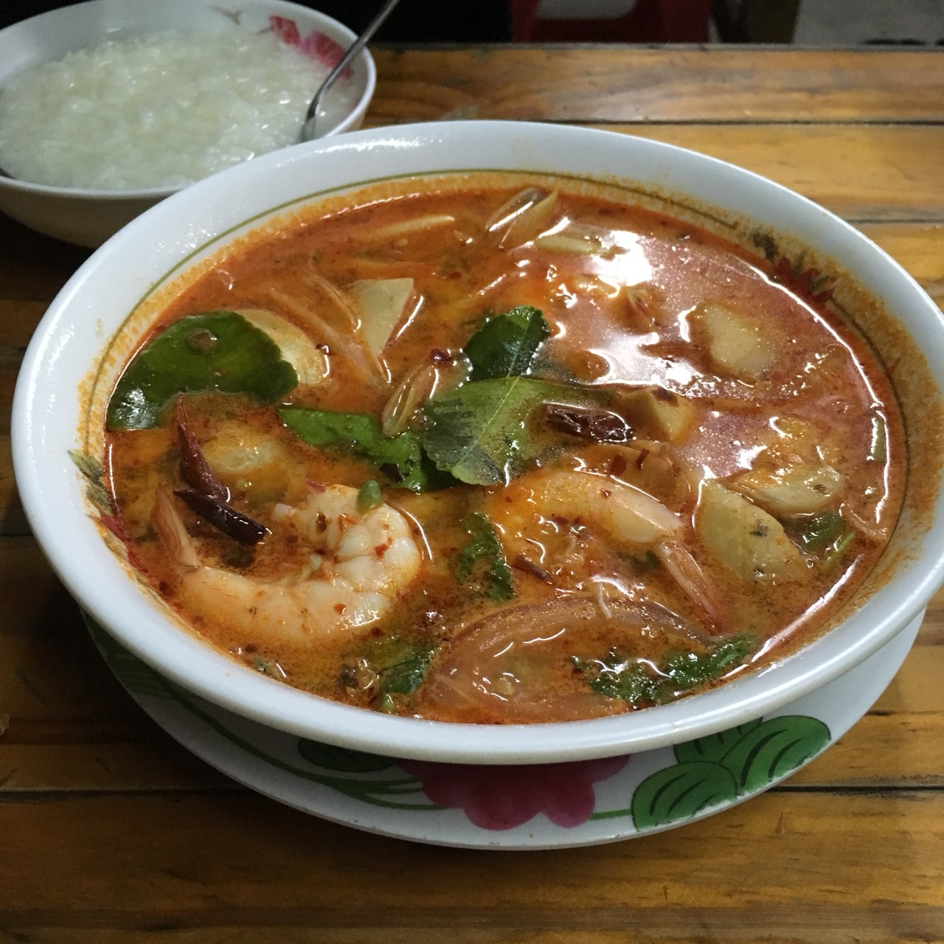
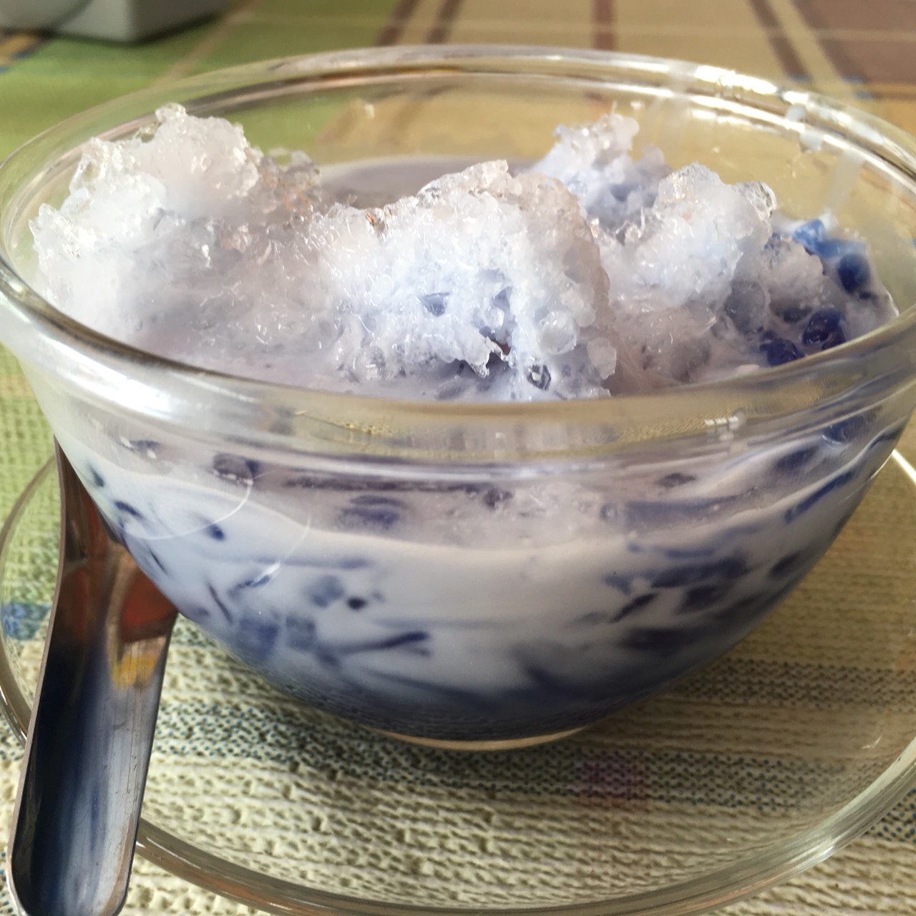
Food in Thailand
Notes:
Every food in Thailand is very delicious for me. I think especially these are delicious. パタイ、カーオホッカッピ、トムヤンクン、ローチオンシンガポール。 every food in Thailand is only spicy or sweet. However I like Thai food. When I go back Japan, I will go to Thai food shops. moreover yesterday teacher gave me this seed"coriandar ﾊﾟｸﾁー" so , I will grow this.

Slide 5
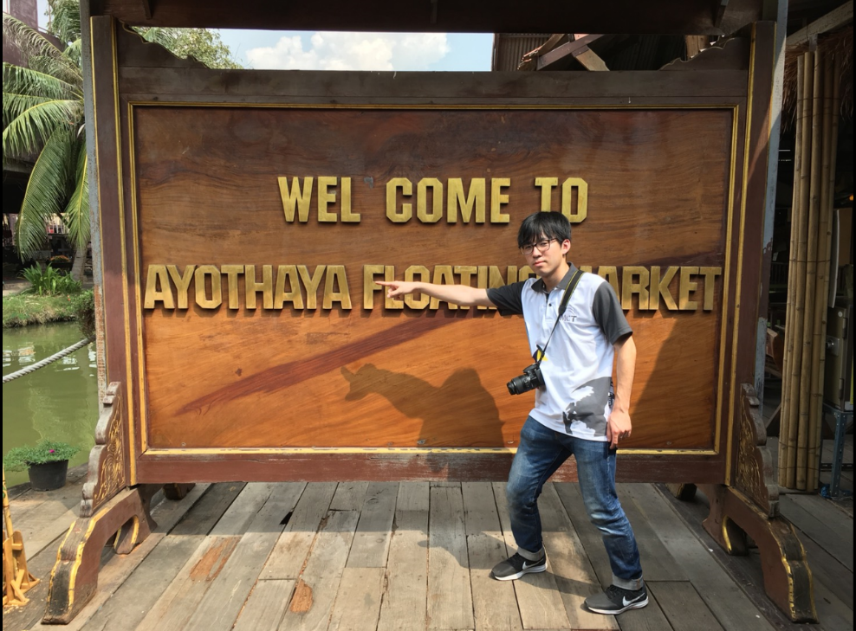
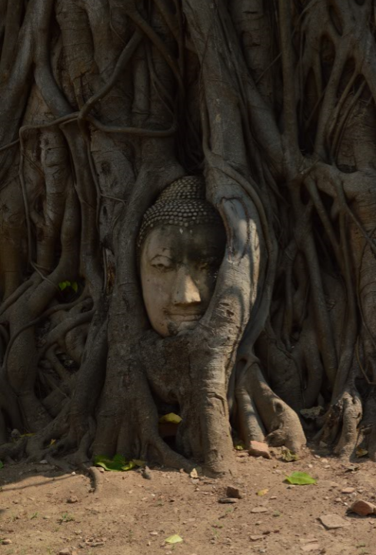
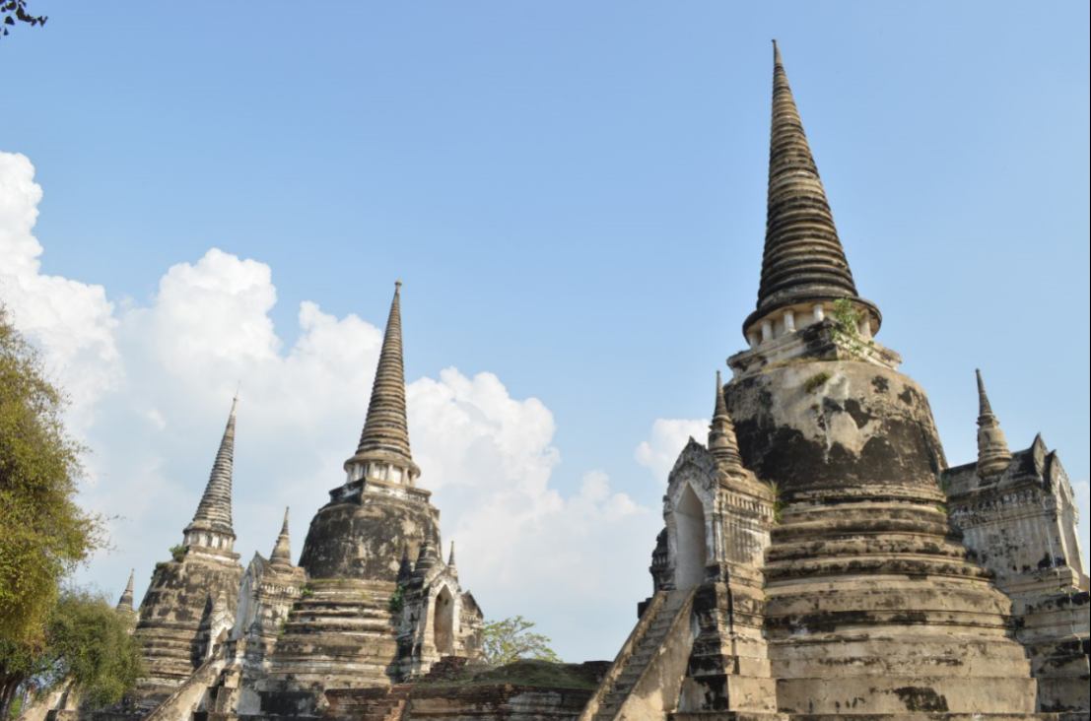
Historical Places in Thailand
Notes:
I saw many historical places in Thailand. I remember vividly going a little trip of taking pictures of historical places. Thanks​ to this class, I am a lot interested at taking pictures. Moreover, I recognize F-stop, shutter speed, ISO are very important.

Slide 6
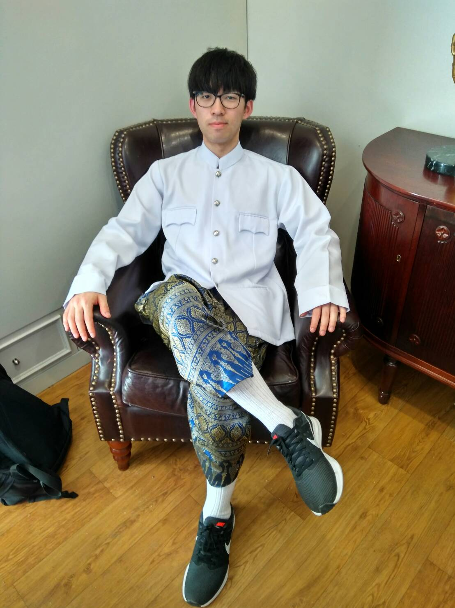
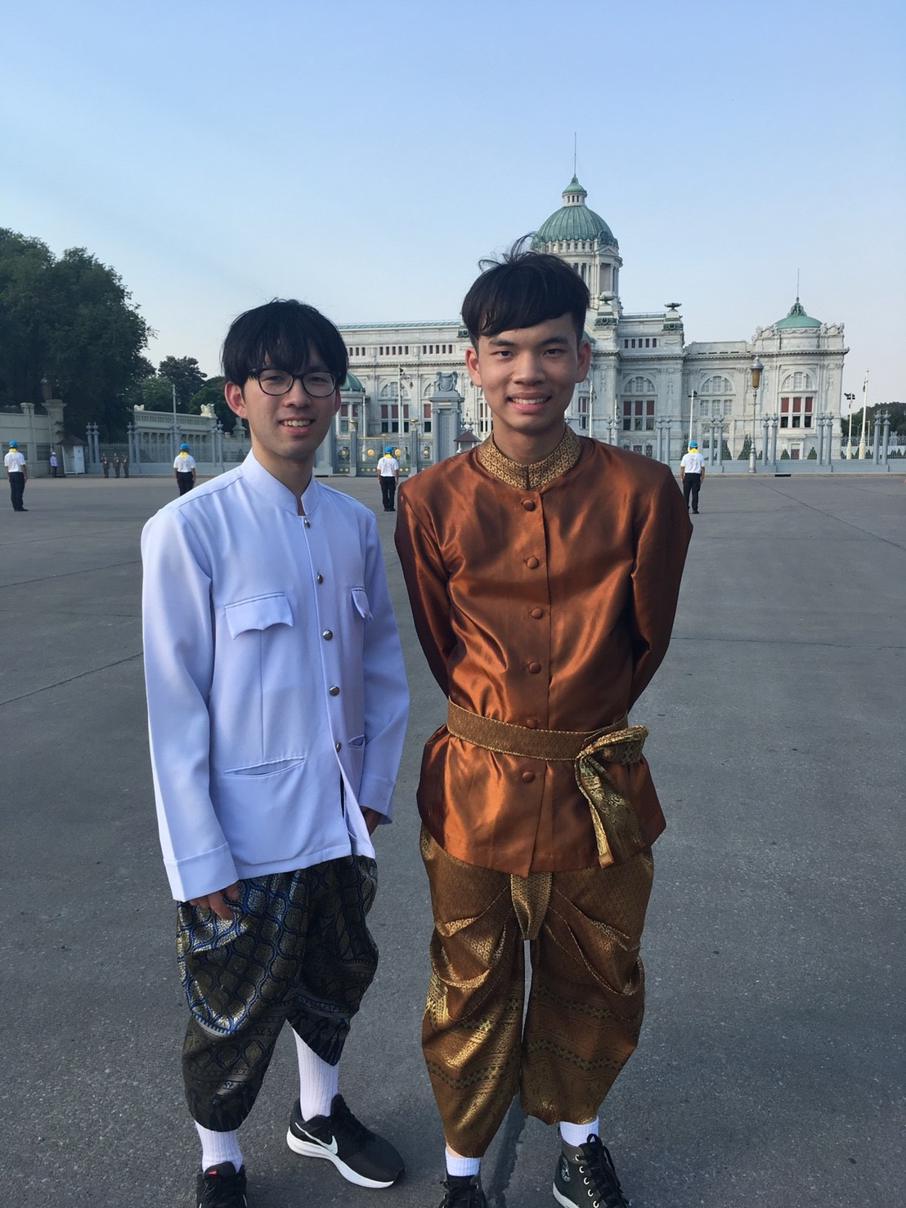
Clothe culture in Thailand
Notes:
I wore Thai traditional clothes. you will think this cloth is not comfortable, but this is comfortable for me. When I saw someone there, I noticed that there are many kinds of Thai traditional cloths. Next when I go to Thailand , I want to wear other Thai traditional clothes!

Slide 7
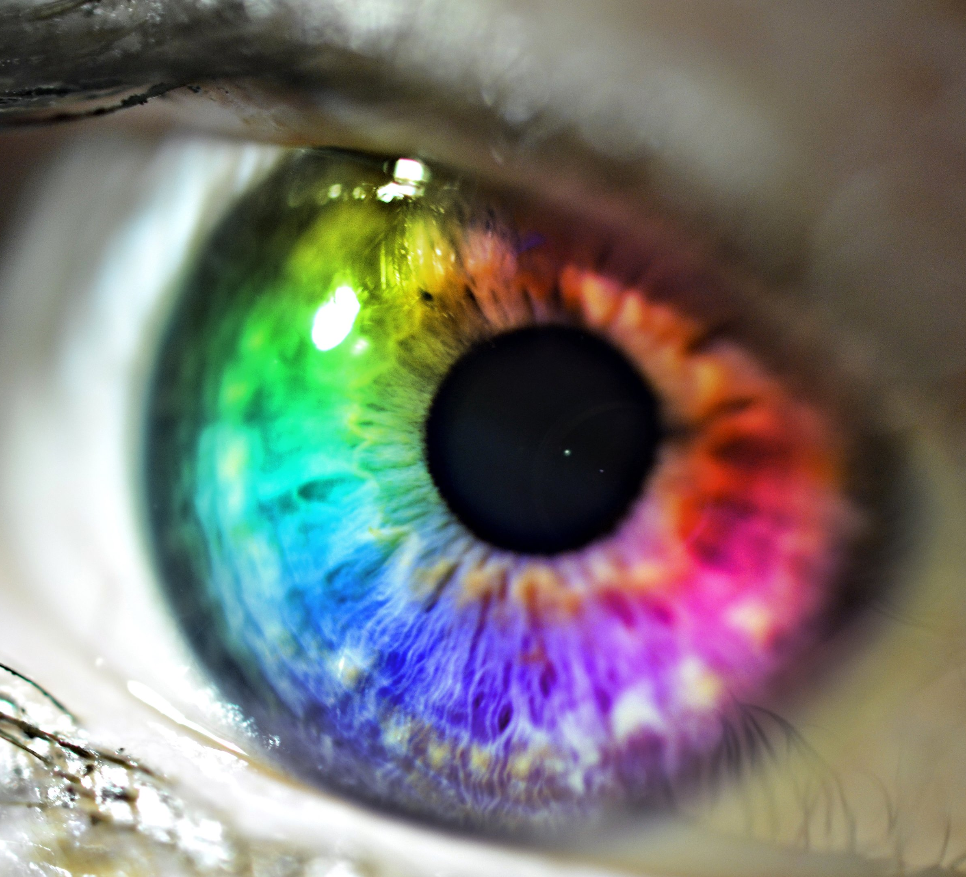
Experiment and various things
Notes:
The next story is a little serious. Second, I am going to talk about Experiment and various things

Slide 8
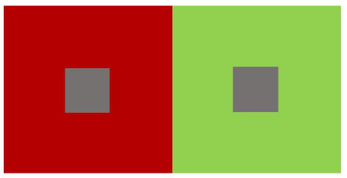
Introdruction about Phubet lab
Simultaneous color contrast
Simultaneous color contrast or color induction is the interaction which one color is affected by the other color in the field of view
Notes:
First Phubet' experiment. He studies the topic about comparison of the simultaneous color constant. Simultaneous color contrast or color induction is the interaction which one color is affected by the other color in the field of view.

Slide 9
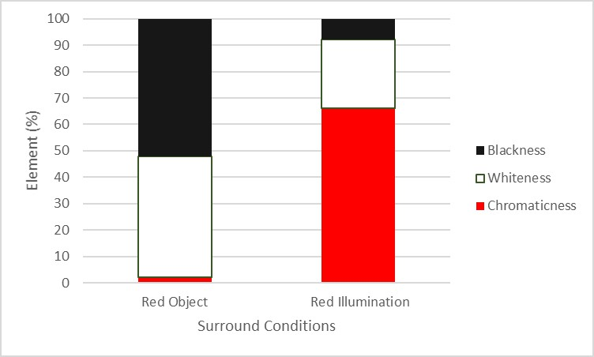
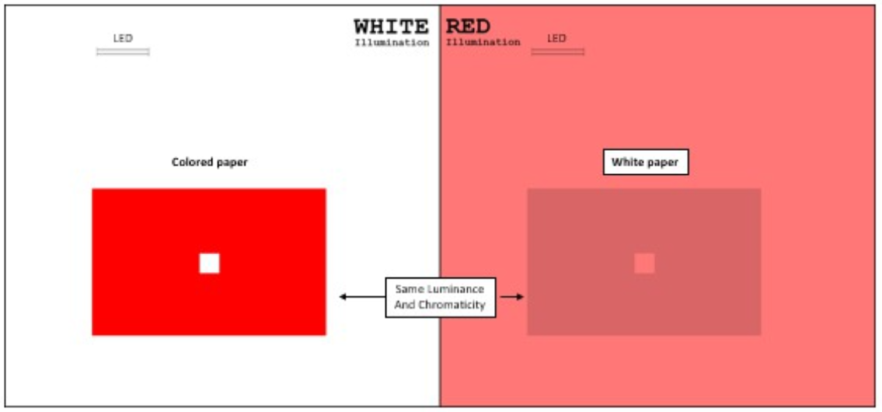
My result about Phubet lab
Notes:
You can see my result. Under White illumination and using red borad, this situation is left bar. Red object. Under Black illumination and using white board, this situation is the other side bar. Red illumination. We can perceive more Chromaticness in Red illumination than that in Red object. When using Yellow, Green, Blue illumination, the result is as same as this one.

Slide 10
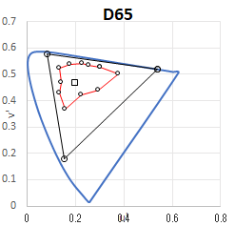
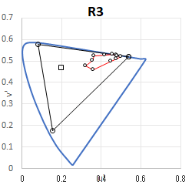
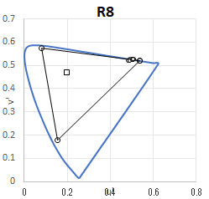
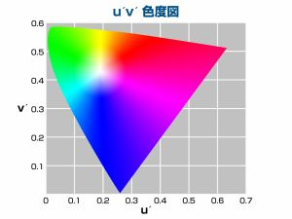
Introudction about Eve lab
Physical measuring of eleven color chips
Notes:
Second Eve's experiment. She studies the topic that she investigate the color appearance of objects under vivid colored LED lights. When using physical measuring, we cannot measure colors except Red. But Our eyes is higher sensitivity for color than physical measuring

Slide 11
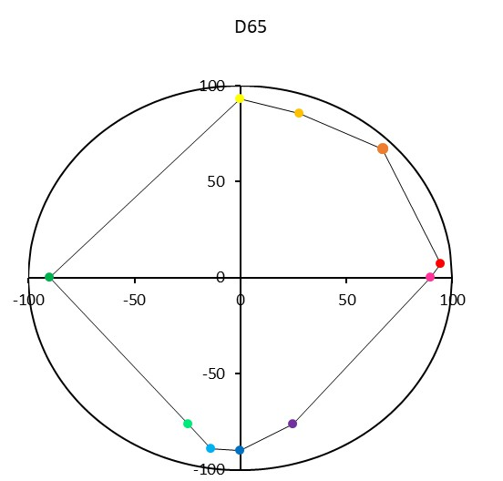
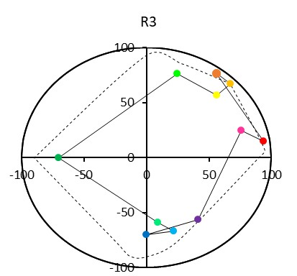
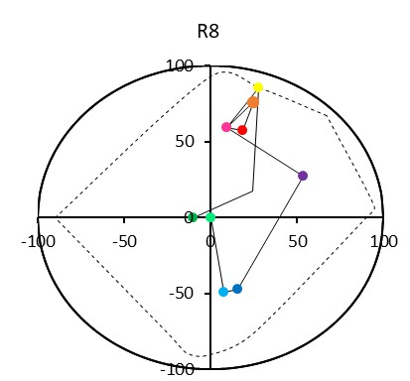
My result of Eve lab
D65
R3
R8
Notes:
You can see my result. Under D65, I can see various color. However, more vivid Illumination is , less I can see colors. I think more times I do the experiment, less different my perception of my eyes and date.

Slide 12
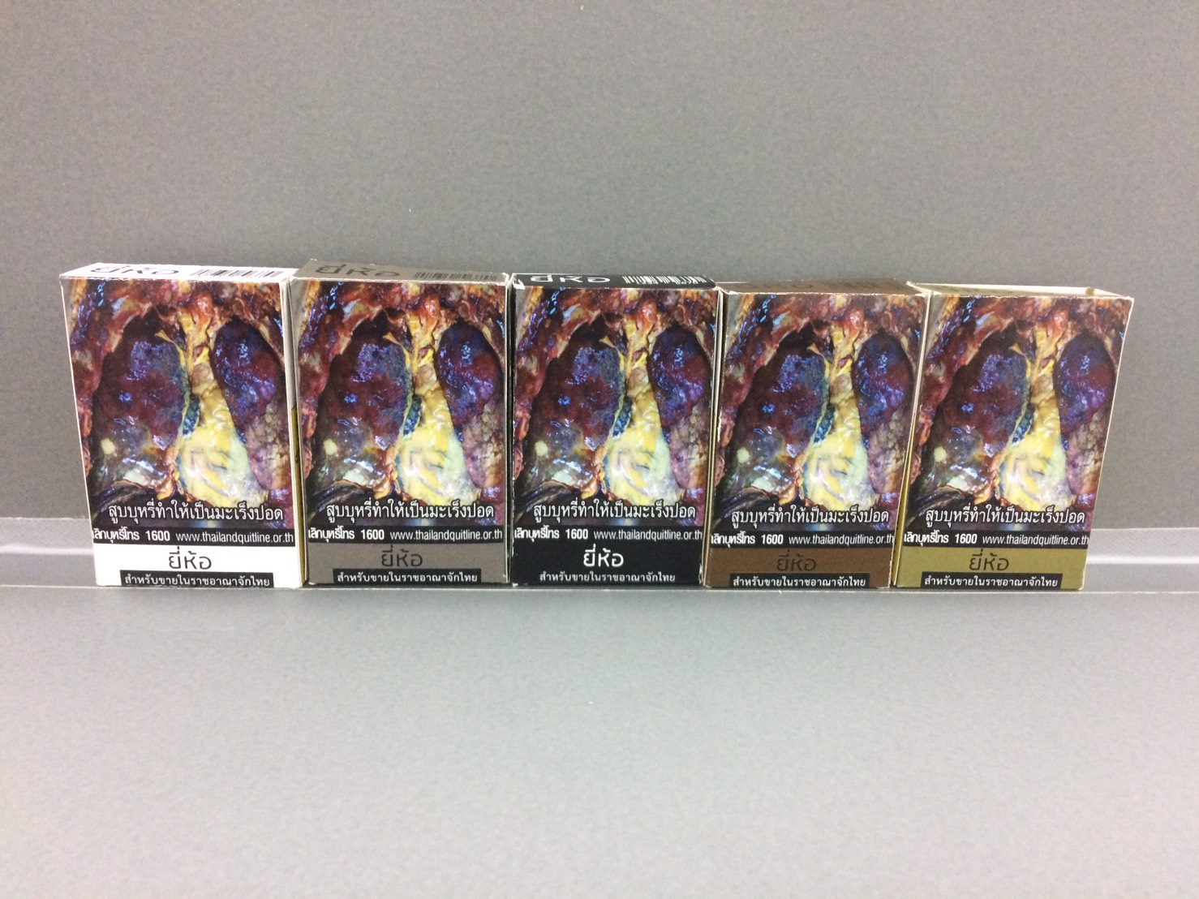
Guw lab
Which one don't you want to buy?
Notes:
Next experiment is Guw's experiment. Which one don't you want to buy? Every box is different color from each other .I don't want to buy Olive Green box. On the other hand, I want to buy White color box.

Slide 13
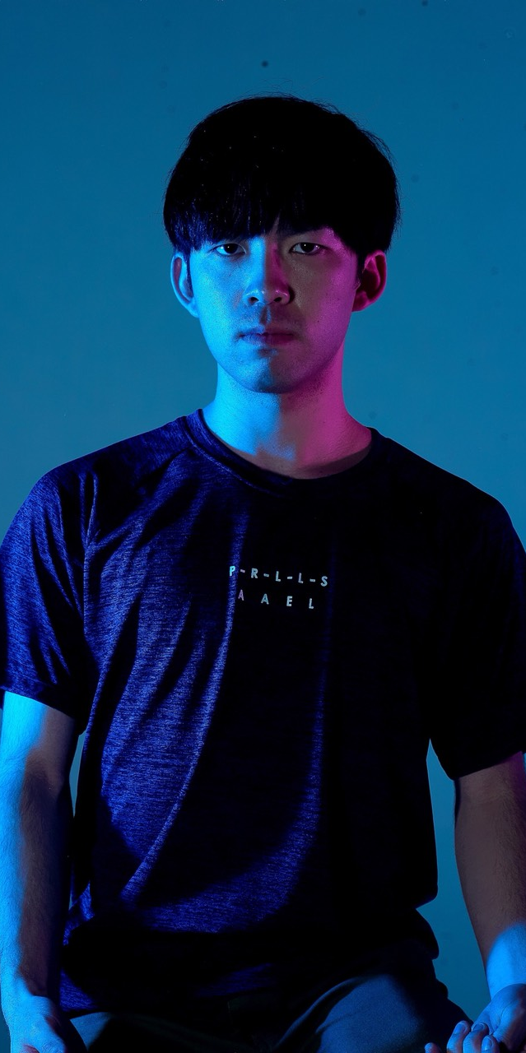
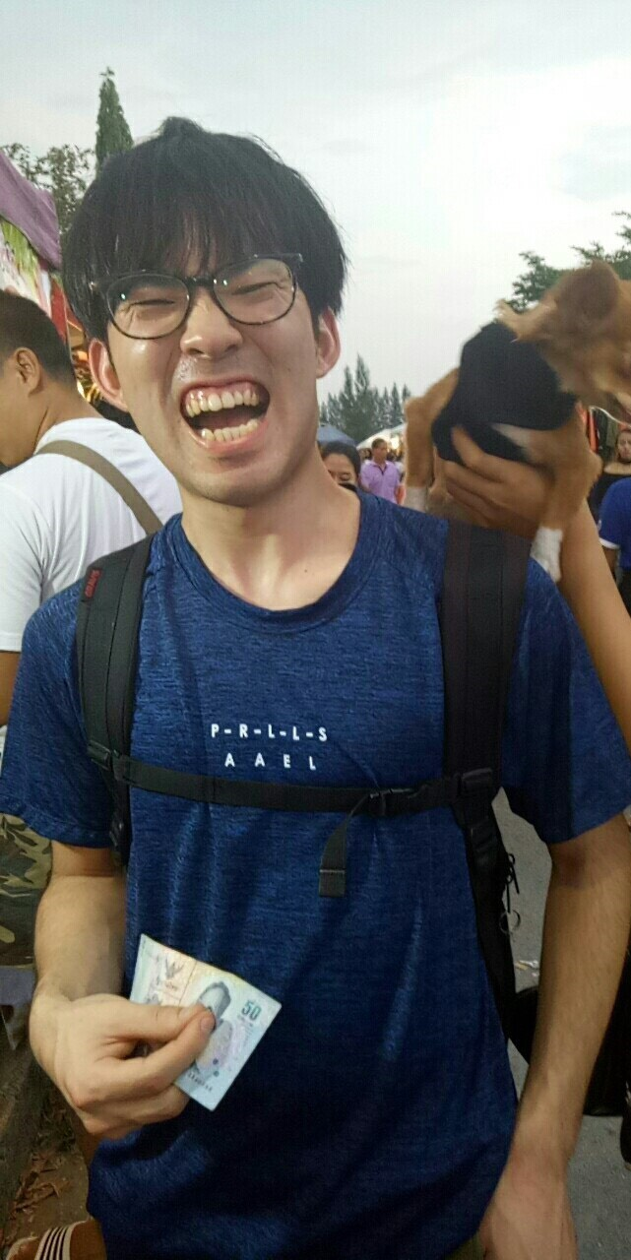
Studio photography
Same person
Notes:
I studied lighting in RMUTT. I am amazed by how cool the studio is!!! Lighting makes me cool . You never understand this guy and this guy and me are same parson. When in this case in Thailand, someone says that they are twin, or brother.

Slide 14
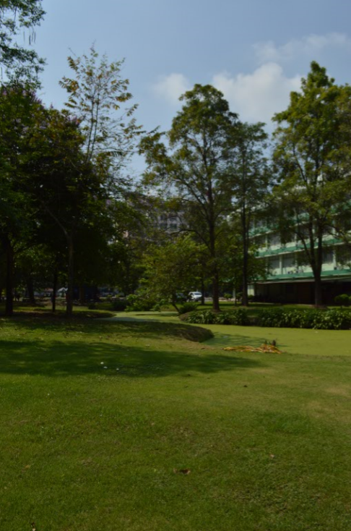
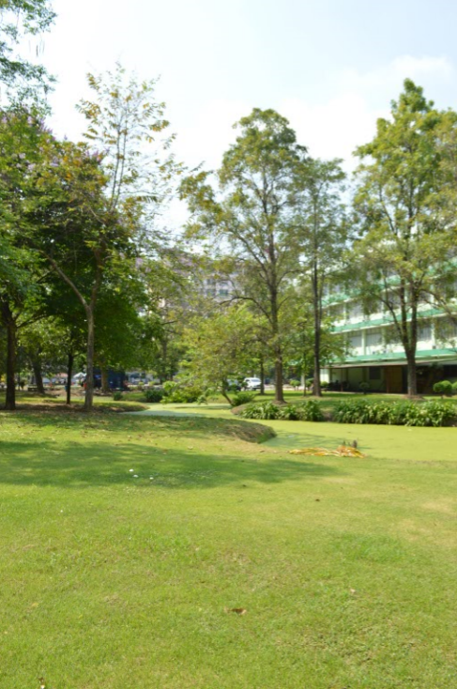
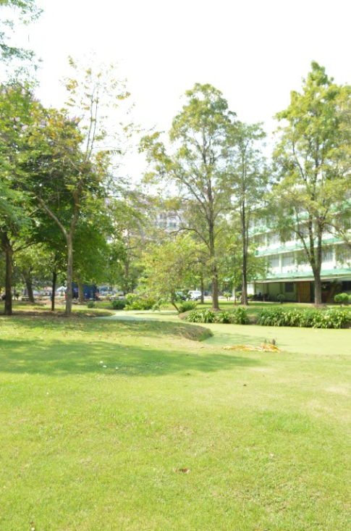
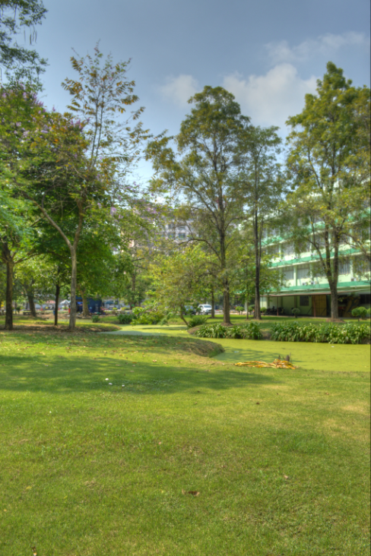
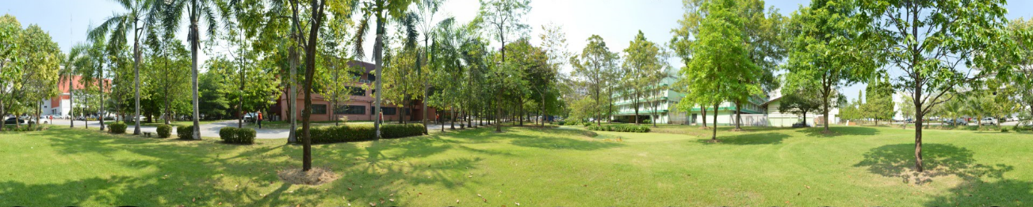
HDR , Panorama
Notes:
Teacher taught me how to make HDR Panorama, and what system HDR Panorama is. we tried to make HDR. I took 3 pictures changed Exposure value. We got a HDR picture using Software of photomatrix pro. Moreover I make Panorama using Software of PTGui.

Slide 15
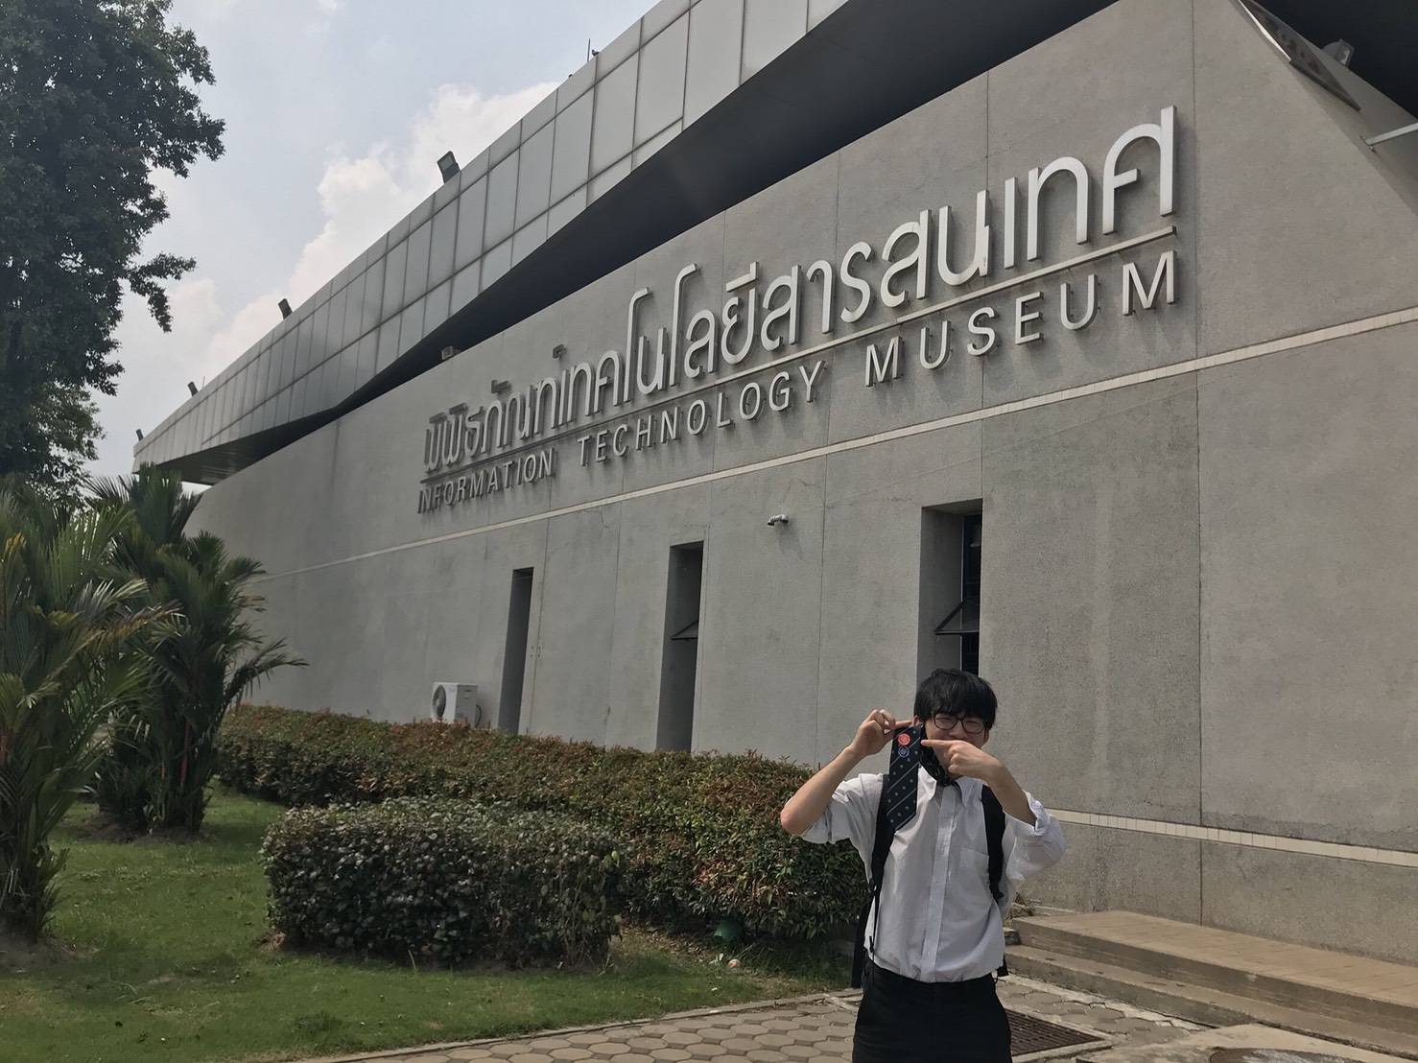
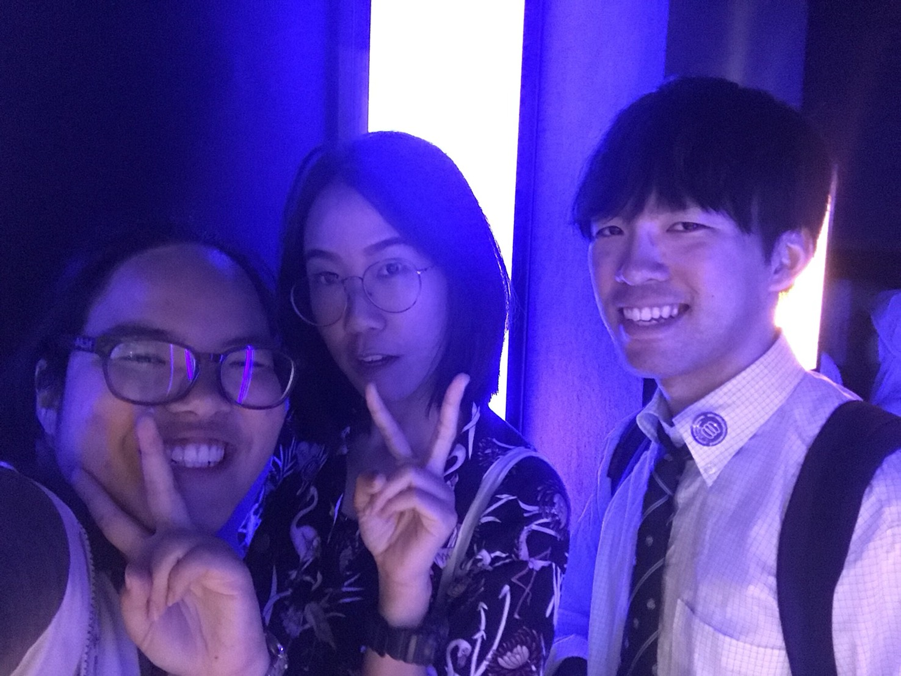
Broadcasting Television
Notes:
Yesterday, we went to Information technology museum. Needless to say, This museum is in Thailand so Wall label is all English or Thai language 5555. through this class, I want to know masmedia more.

Slide 16
Last
Thank you for 20 days
To be continued
Notes:
Finally, I want to said to you. Thank you for 20 days. 20 days are short for me. I want to stay in Thailand more. Thanks to you , I experienced a lot.I never forget my memory in Thailand. My ASW 2018 spring season is finished. However , the next turn is you.

Slide 17
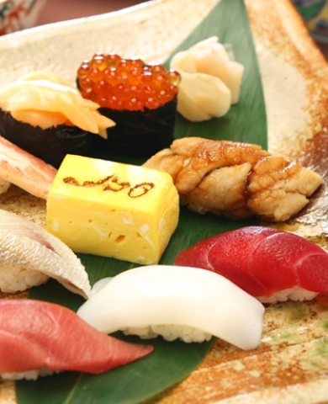
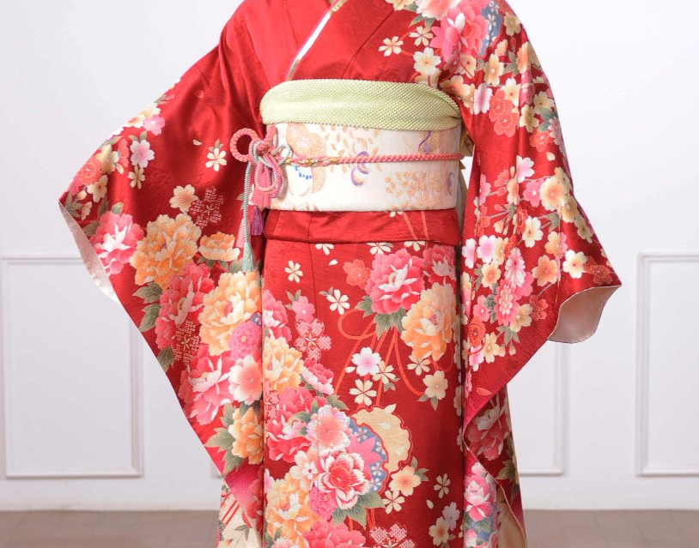
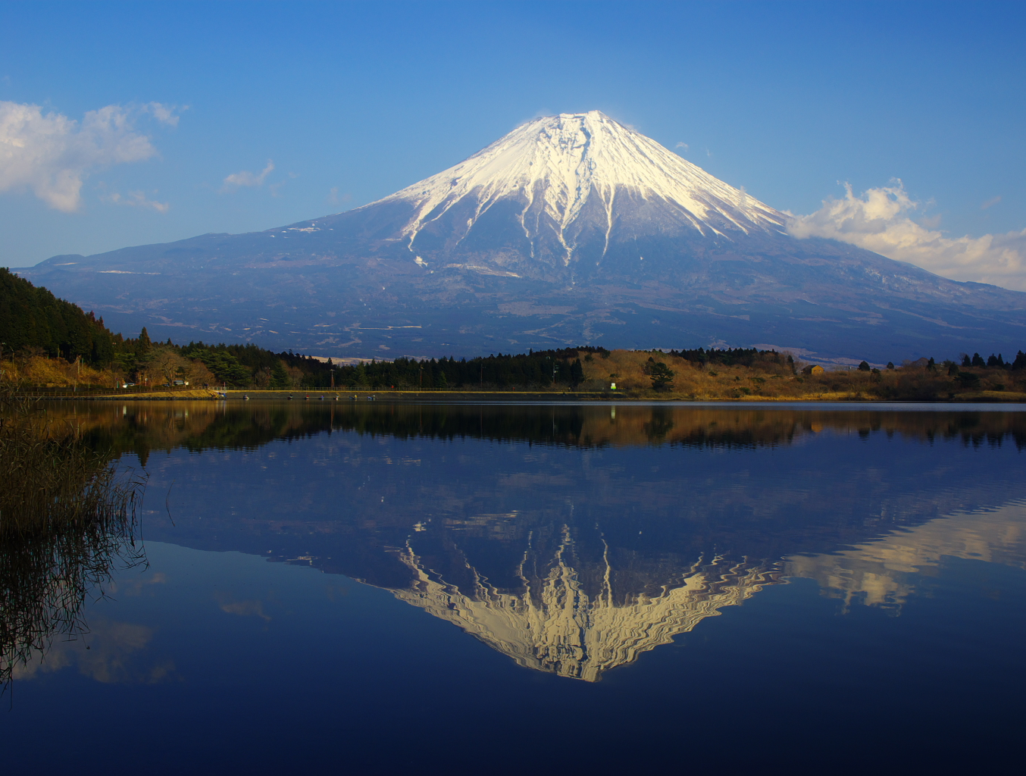
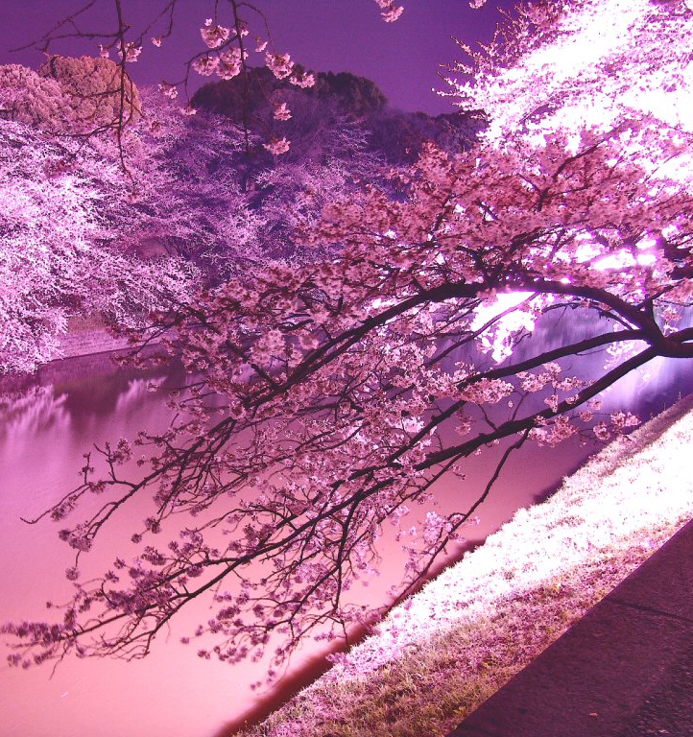
Welcome to Japan
Notes:
We will be able to meet in Japan next 2 weeks. I am looking forward to do .

